Slide 1
Simulation and Modeling
CSE4131_CSE4132

Slide 2
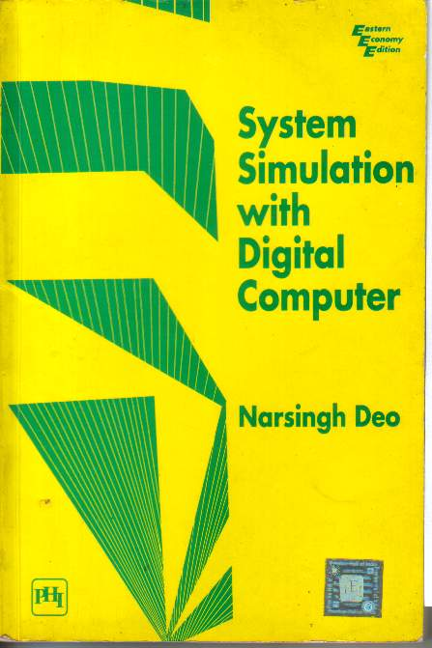
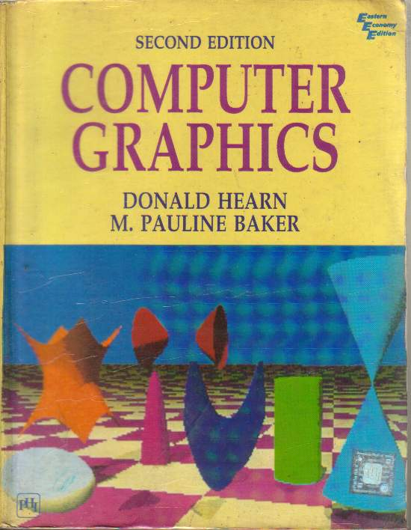
Recommended Books
SYSTEM SIMULATION WITH DIGITAL COMPUTER
- By Narsingh Deo
COMPUTER GRAPHICS
- By Donald Hearn & M. Pauline Baker

Slide 3
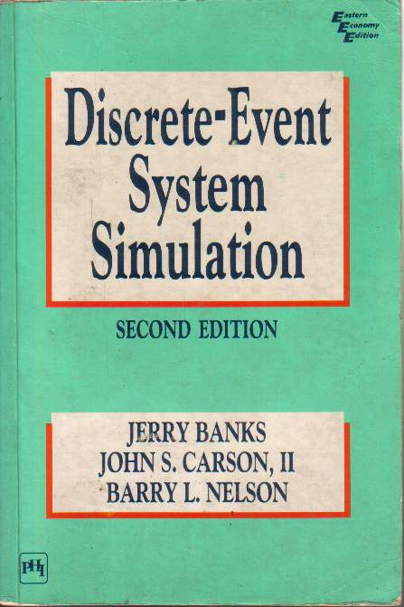
Recommended Books
DISCRETE-EVENT SYSTEM SIMULATION
Jerry Banks, John S. Carson, Barry L. Nelson
Publisher: Prentice- Hall

Slide 4
Practical
C/C++ (Code Block IDE)
SimScript or ModelSim

Slide 5

A Video Introduction of SaM

Slide 6
Simulation
What is simulation? (Formal Definition)
Simulation 🡪 অনুকরন করা
A simulation is the imitation (নকল করা) of the operation of a real world process or system over time.
Can be done:
by hand or on a computer

Slide 7
Definition of System
A system is defined as a group of objects that are joined together in some regular interaction or interdependence toward the accomplishment of some purpose.
A system is often affected by changes occurring outside the system.
Such changes are said to occur in the system environment
… it is necessary to decide on the boundary between the system and its environment

Slide 8
Simulation
Simulation involves
Generation of an artificial history of a system + Observation of that artificial history
=⮚Conclusion …operating characteristics of the real system.

Slide 9
Simulation … Appropriate Tool
SIMULATION … FOLLOWING PURPOSES:
… study of internal interaction of a subsystem … complex system
Informational (say false fire alarm) + organizational (say removing supervisor)+ environmental changes(say introducing lunch) →… find their effects
… to gain knowledge about improvement of system
Finding important input parameters with changing simulation inputs

Slide 10
When Simulation … Appropriate Tool
… with new design and policies before implementation
… different capabilities for a machine can help determine the requirement.
… for training …without the cost disruption.
A plan can be visualized with animated simulation
The modern system (factory, wafer fabrication plant, service organization) is too complex that its internal interaction can be treated only by simulation

Slide 11
When Simulation Is Not Appropriate
When the problem can be solved by common sense.
When the problem can be solved analytically (logically).
If it is easier to perform direct experiments.
If cost exceed savings.
If resource or time are not available.
If system behavior is too complex.
Like human behavior

Slide 12
Advantages
New policies, operating procedures, decision rules, information flows, organizational procedures, and so on can be explored without disrupting ongoing operations of the real system.
New hardware designs, physical layouts, transportation systems, and so on, can be tested without committing resources for their acquisition.
Hypotheses about how or why certain phenomena occur can be tested for feasibility.
Time can be compressed or expanded allowing for a speedup or slowdown of the phenomena under investigation.

Slide 13
Advantages
Insight can be obtained about the interaction of variables.
Insight can be obtained about the importance of variables to the performance of the system.
Bottleneck analysis (?) can be performed indicating where work-in-process, information, materials, and so on are being excessively delayed.
A simulation study can help in understanding how the system operates rather than how individuals think the system operates.
What-if questions can be answered. This is particularly useful in the design of new systems.

Slide 14
Disadvantages
Model building requires special training.
Simulation results can be difficult to interpret.
Simulation modeling and analysis can be time consuming and expensive.
Simulation is used in sometime when an analytical solution is possible or even preferable.

Slide 15
Overcome the Limitations
Vendors of simulation software have been actively developing packages that contain models that need only input data for their operation.
Many simulation software vendors have developed output analysis capabilities within their packages for performing very thorough analysis.
Simulation can be performed faster today than yesterday, and even faster tomorrow.
Closed-form models are not able to analyze most of the complex systems that are encountered in practice.

Slide 16
Area of application
Manufacturing Systems
Aircraft, Automobile…
Semiconductor Manufacturing
Public systems
Health care –prediction of pharmaceutical costs and outcome
Military – army officer professional development
Natural resource – solid waste management system
Transportation System
i.e. cargo transport system

Slide 17
Area of application
Construction systems
i.e. cable-stayed bridge…
Restaurant and entertainment system
Quick service restaurant traffic analysis
Business process reengineering
Business process modeling and analysis tools
Food processing
Fishing boat operations in fish processing industries
Computer system performance
Client-server system architecture….

Slide 18
Definition of System
A system is defined as a group of objects that are joined together in some regular interaction or interdependence toward the accomplishment of some purpose.
A system is often affected by changes occurring outside the system.
Such changes are said to occur in the system environment
… it is necessary to decide on the boundary between the system and its environment

Slide 19
Components of a System
Entity- An object of interest in the system : Machines in factory
Attribute- The property of an entity : speed, capacity
Activity- A time period of specified length :welding, stamping
State- A collection of variables that describe the system in any time : status of machine (busy, idle, down,…)

Slide 20
Components of a System
Event- A instantaneous occurrence that might change the state of the system: breakdown
Endogenous- Activities and events occurring with the system.
Exogenous- Activities and events occurring with the environment.

Slide 22
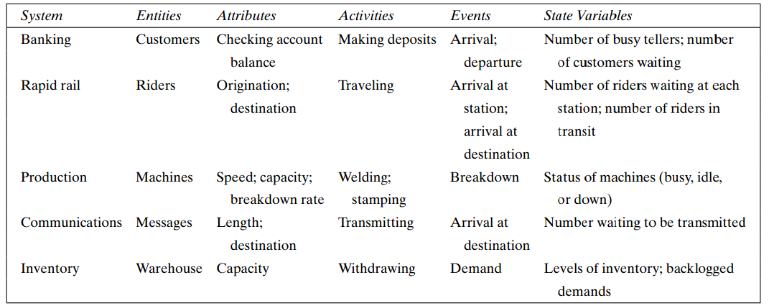
Example of System and its components…

Slide 23
System
System can be categorized into
Discrete System
Continuous System

Slide 24
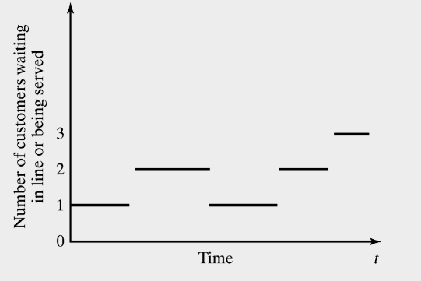
Discrete and Continues Systems
A discrete system is one in which the state variables change only at a discrete set of points in time : Bank example

Slide 25
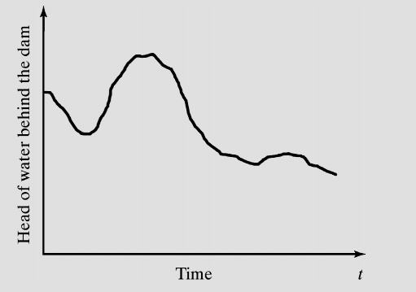
Discrete and Continues Systems (cont.)
A continues system is one in which the state variables change continuously over time: Head of water behind the dam

Slide 26
Model of a System
To study the system
it is sometimes possible to experiment
This is not always possible (bank, factory,…)
A new system may not yet exist
Model:
construct a conceptual framework that describes a system
It is necessary to consider those accepts of systems that affect the problem under investigation (unnecessary details must remove)

Slide 27
Types of Models & System Models
Models can be classified 🡪 mathematical, physical & process.
A mathematical model uses symbolic notation and mathematical equations to represent a system.
A simulation model is a particular type of mathematical model of a system.
System Models may be further classified as:
STATIC OR DYNAMIC,
DETERMINISTIC OR STOCHASTIC,
DISCRETE OR CONTINUOUS

Slide 28
STATIC & DYNAMIC Models
A STATIC SIMULATION MODEL : represents a system at a particular point in time.
sometimes called a Monte Carlo simulation
DYNAMIC SIMULATION MODELS: represent systems as they change over time.
The simulation of a bank from 9:00 A.M. to 4:00 P.M. is an example of a dynamic simulation

Slide 29
DETERMINISTIC & STOCHASTIC
Simulation models that contain no random variables are classified as deterministic .
Deterministic models have a known set of inputs which will result in a unique set of outputs.
A stochastic (sto·chas·tic) simulation model has one or more random variables as inputs.
Random inputs lead to random outputs.

Slide 30
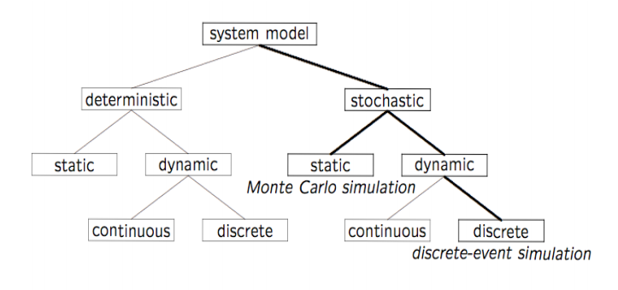
Types of System Models

Slide 31
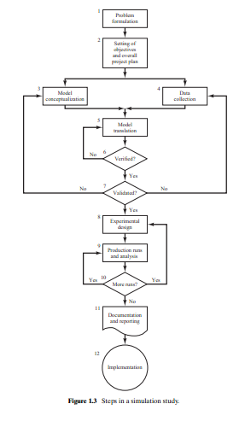
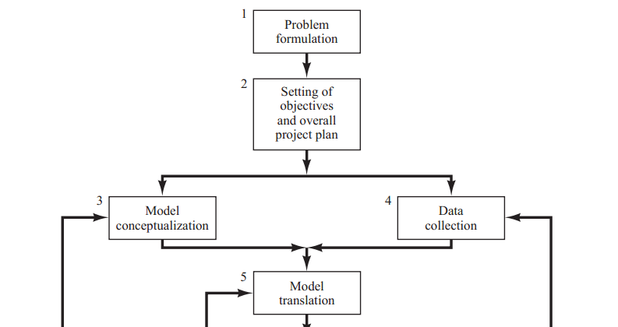
STEPS IN SIMULATION STUDY

Slide 32
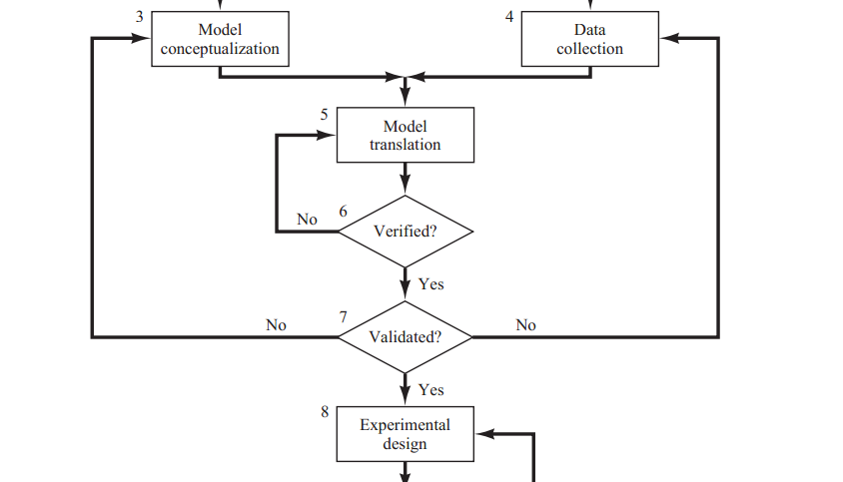

Slide 33
